Slide 1
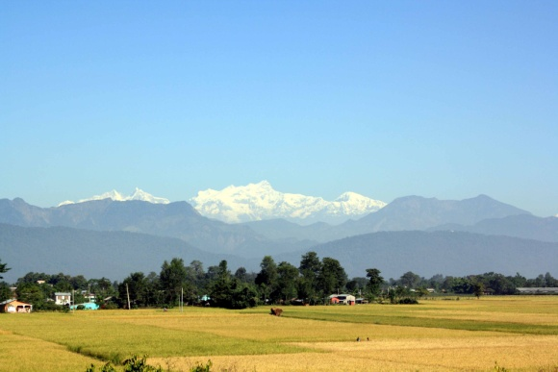
Chitwan Valley Family Study on Cognition and Ageing in Nepal (CVFS-SCAN)

Slide 2
Application time line and current status
First submission: November 2020
Reviewed: March 2021
Scored: Impact score 42 Percentile 33%
Pilot Study
Second submission: November 2021
Reviewed: March 2022
Scored: Impact score 30 Percentile: 15%
Council Meeting: May 2022- Recommended for funding

Slide 3
International Labor Migration, Armed Conflict and Dementia Risk in Nepal: A Population Study

Slide 4
General Objectives
1) Build capacity for the conduct of systematic population research in Alzheimer disease and related dementias (ADRD)
2) Develop a new, longitudinal study of ADRD and other aging-related changes in health in older adults in Nepal.

Slide 5
Specific aims
1) Build research capacity for the conduct of studies of ADRD and other aging-related changes in health. Specific capacity-building activities focus on (1) the design and administration of culturally appropriate cognitive assessments to identify ADRD in the general population, and (2) building expertise in statistical methods for the analysis of longitudinal data from complex surveys.
2) Design and conduct a population-based study of ADRD and other age-associated conditions of 4,000 adults aged > 50 years and complete a baseline interview and one follow-up interview two years later.
3) Estimate the prevalence and incidence of ADRD and its primary clinical feature: cognitive impairment; test associations between primary risk factors and ADRD/cognitive impairment and other relevant outcomes (e.g., disability, caregiving needs) at baseline and follow-up. In these analyses, we will test the specific hypotheses that longer duration of international labor migration and exposure to armed conflict are associated with an increased risk of ADRD/cognitive impairment.

Slide 6
Research team
Nepal
Dr. Uttam Sharma, Economist, Research Scientist, ISER-N | Lead, Co-I
Dr. Pankaj Jalan, M.D., Neurologist, Norvic International Hospital | Co-I
Dr. Meeta Pradhan, Ph.D., Social Demographer Research Scientist, ISER-N | Co-I
Dr. Janak Rai, Ph.D., Anthropologist, Associate Professor Tribhuvan University Nepal | Co-I
United States
Dr. Carlos Mendes de Leon, Epidemiologist, Georgetown University, Washington DC | MPI
Dr. Dirgha Ghimire, Ph.D., Social Demographer, Professor University of Michigan and Director, ISER-N | MPI
Dr. Emily Briceno, Ph.D., a neuropsychologist and Clinical Associate Professor University of Michigan | Co-I
Dr. Kenneth Langa, M.D., Cyrus Sturgis Professor of Medicine, University of Michigan | Co-I
Dr. Colter Mitchell, PhD., Associate Professor in the Survey Research Center, University of Michigan | Co-I
Dr. Brady West, Ph.D., Professor in the Survey Research Center University of Michigan | Co-I
Consultants:
Dr. Jinkook Lee, PhD Professor and Director of Program on Global Aging, Health & Policy, University of Southern California
Dr. Martin Prince MD, MSc FRCPsych Professor and Director, King’s Global Health Institute, University of London
Dr. David R. Weir Professor, Director, Health and Retirement Study, Institute of Social Research, University of Michigan

Slide 7
Research Methods
Study methods
Quantitative method
Study design
longitudinal cohort study
Study Populations
Representative sample of 4,000 older adults and their 4,000 key informants/caregivers from the Chitwan Valley.

Slide 8
Sampling unit
Individuals aged 50 and older people
Sample size
4,000 individuals aged 50 and above, and 4,000 caregivers/informants aged 18 and above
Sampling Technique
Stratified two stages cluster area probability sample

Slide 9
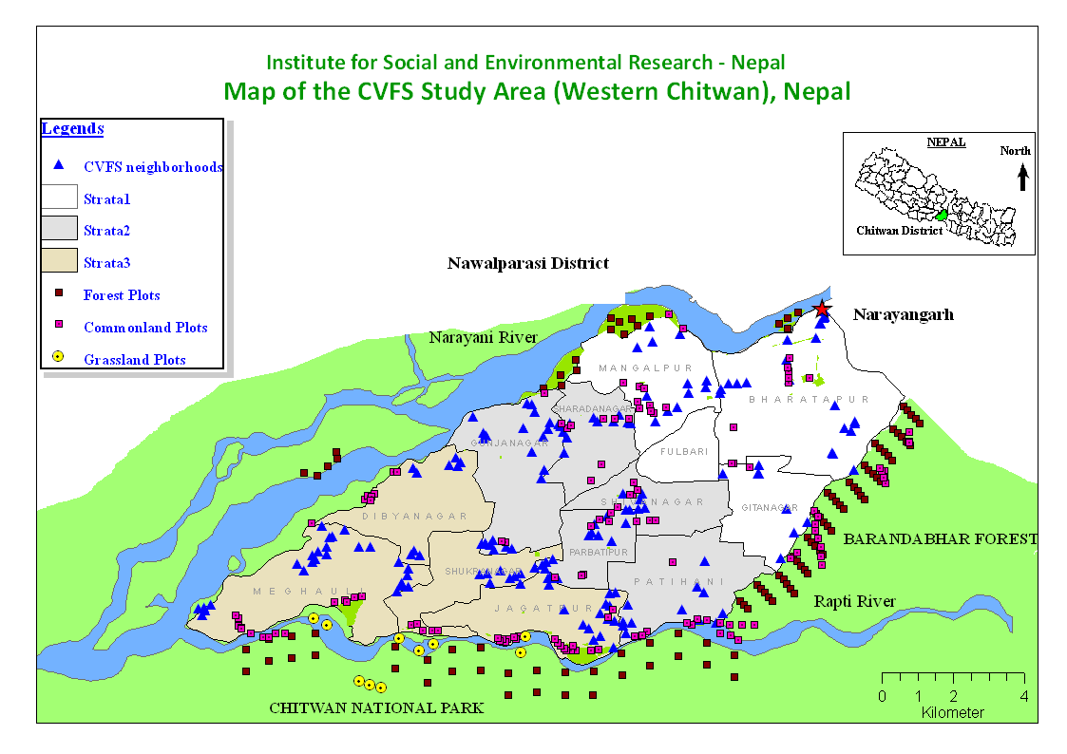
Study area
Case Controlled Comparison

Slide 10
First stage
Stratified into three strata based on distance from the town of Narayanghat, such that each stratum has approximately the same number of settlements (tols).
The primary sampling unit (PSU) of selection was a settlement (range 5-1,000 households).
Of the total of 198 settlements, 10 in each stratum were selected (30 total) using probability proportional to population size.

Slide 11
Second stage
A sample of 4 secondary sampling units (SSUs) was randomly selected from each selected PSU.
Additional SSUs were selected to oversample specific ethnic groups (Newar and Tibeto-Burmese); 151 SSUs were selected, and all households within a SSU were included for a total of 1,581 households.

Slide 12
We project that by 2024; about 4,000 CVFS participants will be age-eligible and agree to participate in the proposed new study, after accounting for attrition due to death, lost/moved out, and non-response.

Slide 13
Instruments and Tools
Survey
The Harmonized Cognitive Assessment Protocol (HCAP)
Biomarker
Venomous blood sample
extracting the blood sample into: i) plasma, ii)serum, iii) buffy coat and iv) red cell,

Slide 14
Survey Instruments and Technique
HCAP
Respondent Interview
Informant/Caregiver Interview

Slide 15
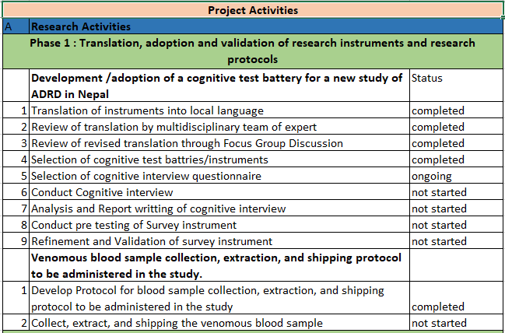

Slide 16
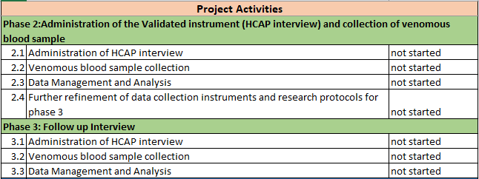

Slide 17
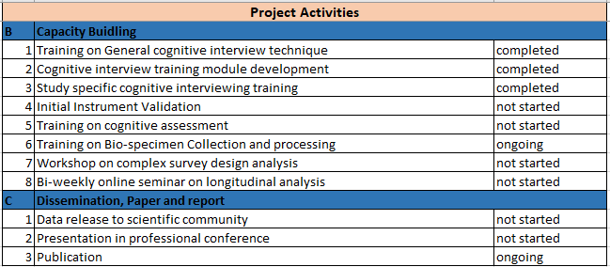

Slide 18
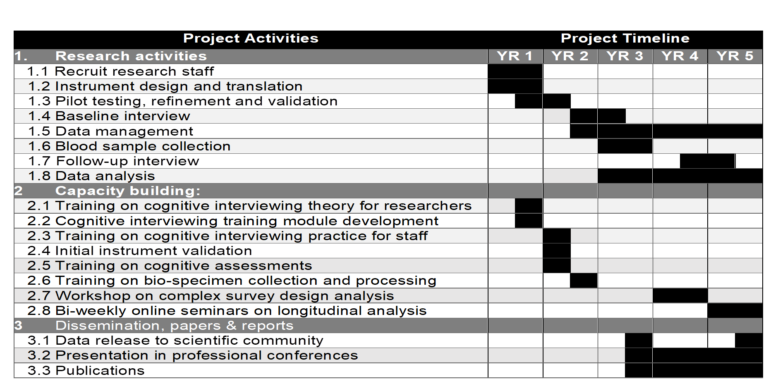
Timeline

Slide 19
Thank you!

